Slide 1
Balanced and Well-spread Subsampling for Better Phylogenetic Inferences in Epidemiology
Hands-On Practical: Detecting & Mitigating Sampling Bias with PAST
2026/10/16
Guppy Stott (they/them)
stott.garrick@gmail.com
Institute of Bioinformatics, Center for the Ecology of Infectious Diseases, University of Georgia

Slide 2
What to Expect
Lab-to-Epi workflow & why sampling bias matters
How PAST balances convenience surveillance data
Tool walkthrough: inputs, interface, & outputs (≤30 min)
Small-group exercise: interpreting outputs (15 min)
Large-group debrief & discussion answers (10 min)

Slide 3
Learning Objectives & Pre-Session Setup
Practical Session Learning Objectives:
  Detect geographic, temporal, and host sampling biases in genomic surveillance datasets
  Evaluate how different subsampling strategies handle missing or skewed sequence data
  Assess the reliability of phylogenetic conclusions before guiding outbreak response
Session Format & Pre-Session Instructions:
  Hands-on interpretation focus: No command-line coding or software installation required prior to today’s session
  Download the practical packet: example FASTA alignment, surveillance metadata CSV, and pre-generated PAST output figures
Part 1/5: Introduction

Slide 4
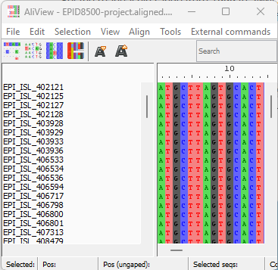
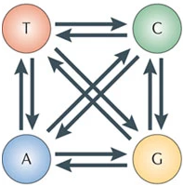
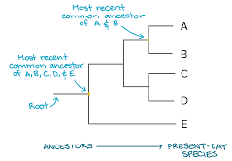
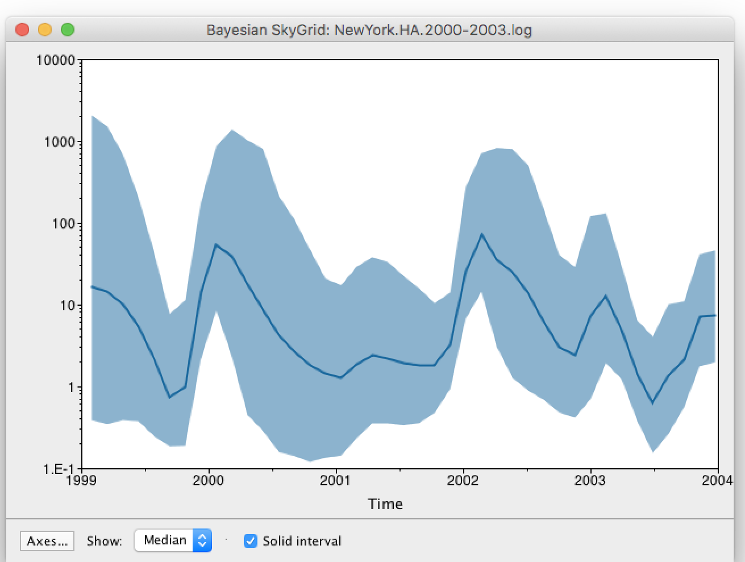
What is phylogenetic inference?
As viruses replicate, mutations accumulate in their genomes and act as genetic timestamps
Sequence data provide a record of a pathogen’s transmission and evolutionary history
Combining genomic trees with surveillance metadata helps estimate introductions, geographic spread, and effective reproduction number (Rt)
Part 1/5: Introduction
Notes:
Sequence data contain a record of mutations over time
Molecular epidemiology uses the information contained in sequence data to infer evolutionary histories and infer epidemiologically relevant parameters

Slide 5
Where Subsampling Fits: Lab-to-Bioinformatics-to-Epi Workflow
1. Clinical & Field Surveillance (Lab & Field Epidemiology):
  Collect specimens, run diagnostic sequencing, and log case metadata (collection date, jurisdiction, host species, regional case counts)
2. Data Curation & Subsampling (Bioinformatics):
  Merge sequence repositories with surveillance metadata and run PAST (github.com/glstott/past) to select a balanced subsample before tree inference
3. Outbreak Interpretation & Public Health Action (Epidemiology):
  Interpret cross-jurisdiction importation rates, source-sink dynamics, and 95% credible intervals to prioritize surveillance and interventions
Part 1/5: Introduction

Slide 6
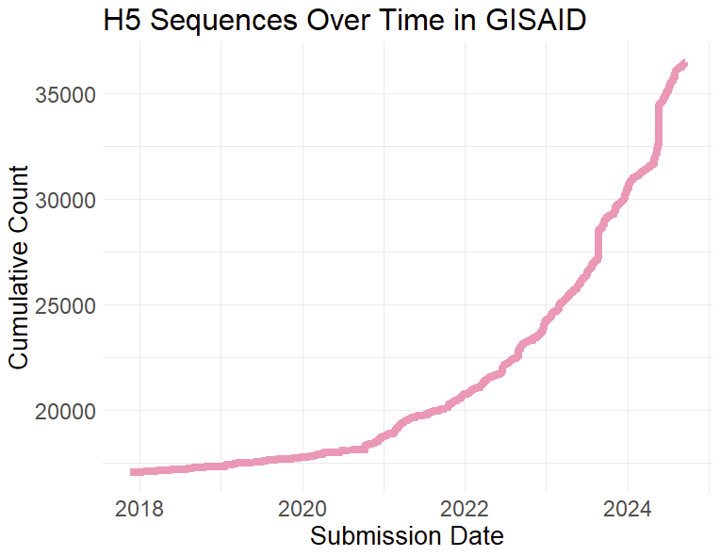
The rapid growth in sequence data has created challenges
Large sequence datasets overwhelm complex outbreak reconstruction models
Sequencing volume is uneven across state/county testing capacity, hospital vs. community sampling, and outbreak-driven testing surges
Part 1/5: Introduction

Slide 7
How can public health teams handle large, biased datasets?
Option 1: Adjust the statistical tree-building model
  Use simplified approximations to speed up runs (sacrifices epidemiological detail)
  Use complex structured models to account for uneven sampling (computationally slow for routine surveillance)
Option 2: Select a representative subsample up front (Our Focus)
  Downsample oversized convenience datasets before running phylodynamic models
  Reduces computation time while mitigating regional, temporal, and host sampling biases
Part 1/5: Introduction

Slide 8
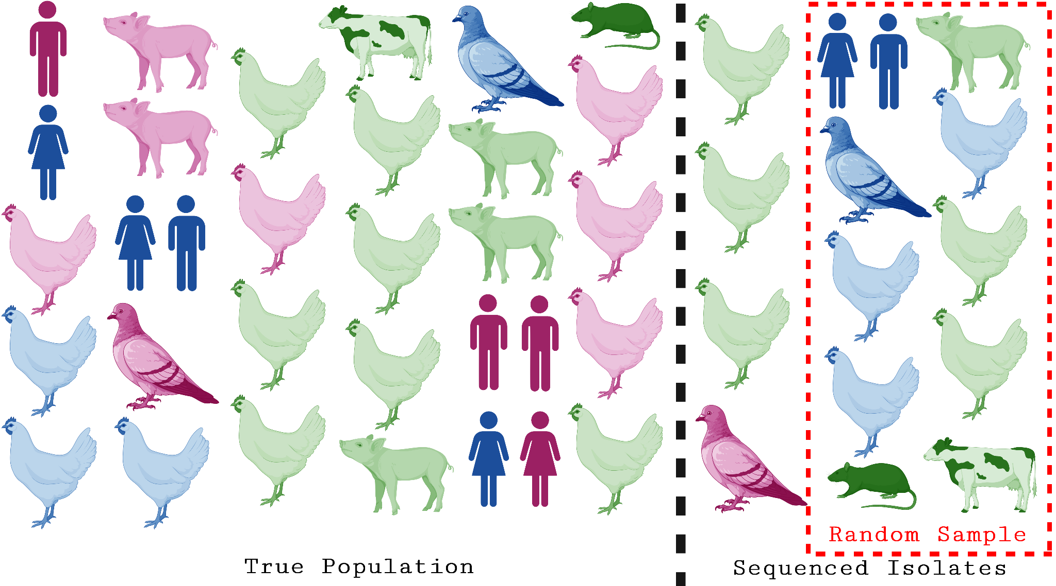
Why does subsampling surveillance sequences pose a challenge?
Publicly available sequences are passive convenience samples shaped by clinical reporting and local lab capacity
Subsampling without accounting for underlying outbreak structure amplifies regional and temporal biases
Part 1/5: Introduction
Notes:
Passive surveillance often over-represents severe clinical cases or well-resourced jurisdictions while under-sampling agricultural or rural spillover events.

Slide 9
Sampling bias can have a significant impact on our phylogeographic analyses
Overall tree reconstruction is accurate when pathogen movement between jurisdictions is low
Uneven regional sequencing strongly distorts estimated cross-jurisdiction transmission and importation rates
1. Liu, P., Yexuan Song, Caroline Colijn & MacPherson, A. The impact of sampling bias on viral phylogeographic reconstruction. PLOS global public health 2, e0000577–e0000577 (2022).
Part 1/5: Introduction

Slide 10
Any downsampling outperforms no downsampling, but some are better than others…
When estimating Rt and regional source-sink dynamics, analyzing raw un-downsampled sequences produces biased point estimates
Opportunistic sampling over-represents jurisdictions with high sequencing capacity rather than true outbreak burden
1. Rhys PD Inward, Nuno R Faria & Parag, K. V. Using multiple sampling strategies to estimate SARS-CoV-2 epidemiological parameters from genomic sequencing data. https://doi.org/10.1101/2022.02.04.22270165 (2022) doi:10.1101/2022.02.04.22270165.
Part 1/5: Introduction

Slide 11
What surveillance metadata should guide subsampling?
 | TARDIS | PARNAS | PDA | CovSampler | Subsampler | PAST (our tool)
Genetic Diversity (Lineages) | + | + | + | + | - | +
Temporal Spread (Collection Date) | + | - | - | + | - | +
Proportional to Case Counts | - | - | - | - | + | -
Weighting (Surveillance Bias) | - | + | - | - | - | +
Host Species Diversity | - | - | - | - | - | +
Spatial Distance (Jurisdiction) | - | - | - | + | - | +
Part 1/5: Introduction
Notes:
How do we subsample for phylogenetic analysis while preserving key epidemiological covariates like jurisdiction, collection date, case counts, and host species?

Slide 12
How PAST Balances Surveillance Data & Tool Walkthrough

Slide 13
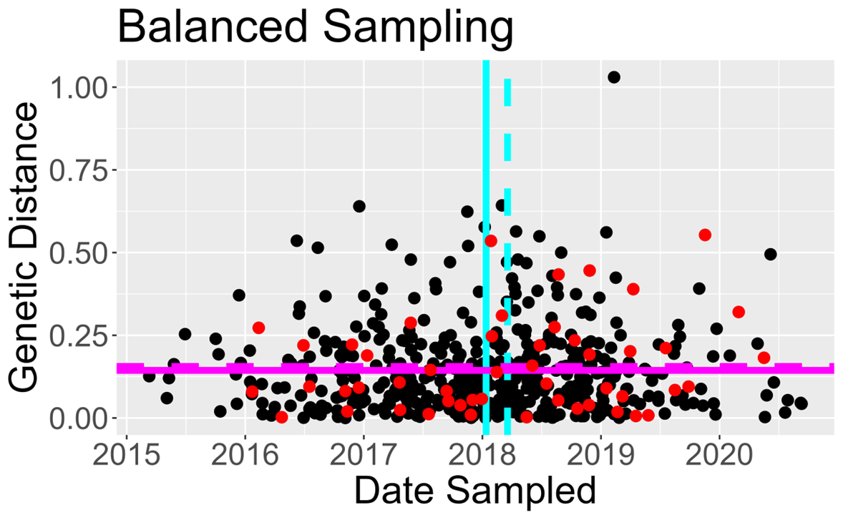
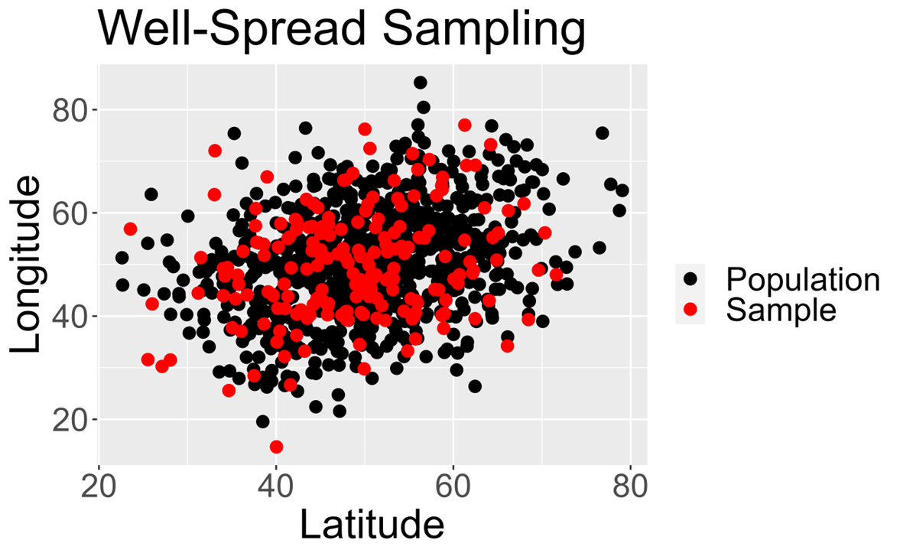
What makes a desirable subsample?
Well-spread samples span the full outbreak timeline and geography—capturing early/late cases and outlying counties without clumping in one cluster
Balanced samples ensure the subsample’s average traits (e.g., proportion of avian vs. human hosts or regional share) match the broader outbreak
Part 2/5: PAST Walkthrough
Notes:
Model-assisted subsampling strategy using the local cube method
Randomly selects a well-spread and balanced subsample across multiple variables
Allows for weighting of sequences to include things like case counts or known biases in sequence availability

Slide 14
How do we achieve a balanced and well-spread sample?
PAST uses the LCUBE method (Grafström & Tillé, 2013), designed for representative ecological and public health surveys
Combines two intuitive principles:
  Spread across clusters: Avoids picking redundant sequences from the exact same local outbreak cluster or epidemic week
  Proportional balancing: Keeps overall subsample proportions aligned with what is observed across the population (host species, jurisdiction, date, or case counts)
Result: Preserves both rare spillover events and overall outbreak proportions
Part 2/5: PAST Walkthrough

Slide 15
Accessing PAST & Input Materials Walkthrough
How to Access PAST (≤30-Minute Walkthrough):
  Source code, documentation, and tutorial files: https://github.com/glstott/past
Input & Output Files Provided to Participants:
  Input Sequence Alignment (.fasta): Aligned viral genomes from the outbreak
  Input Surveillance Metadata (.csv): Sample ID, collection date, jurisdiction/region, host species, and regional case counts for weighting
  Tool Outputs (.csv): Subsampled isolate list
Part 2/5: PAST Walkthrough

Slide 16
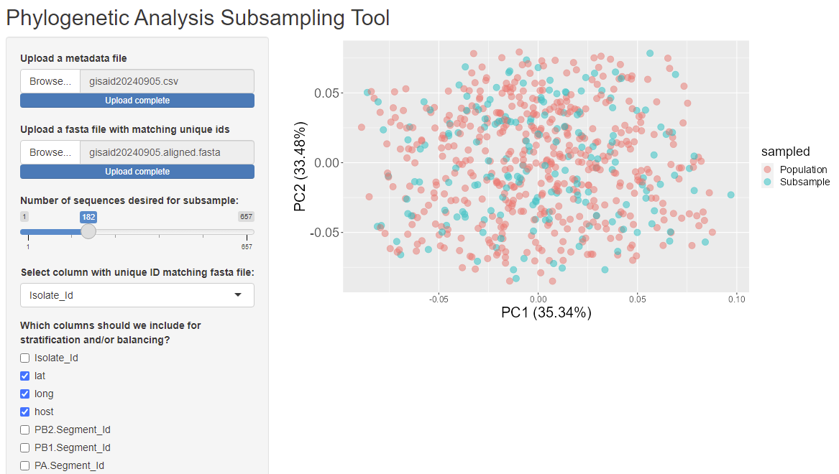
Tool Walkthrough: Point-and-Click GUI Applet for PAST
User-friendly interface designed for epidemiologists (no coding required)
Upload FASTA sequences & metadata CSV, then pick balancing variables
Easily swap between Simple Random, Stratified, and LCUBE strategies
Part 2/5: PAST Walkthrough

Slide 17
Surveillance Scenarios for the Practical

Slide 18
Three Public Health Surveillance Scenarios
We evaluate Simple Random, Stratified Random, and PAST (LCUBE) across three public health surveillance conditions:
  1. Equal Regional Sequencing Capacity (Proportional): Every jurisdiction sequences the same proportion of cases
  2. High- vs. Low-Resource Jurisdictions: One region has lower testing/sequencing capacity and contributes fewer sequences despite active spread
  3. Delayed Regional Surveillance: One region sequences early outbreak isolates but lags behind during later epidemic waves
Goal: Test how each subsampling strategy impacts downstream outbreak conclusions
Part 3/5: Scenarios

Slide 19
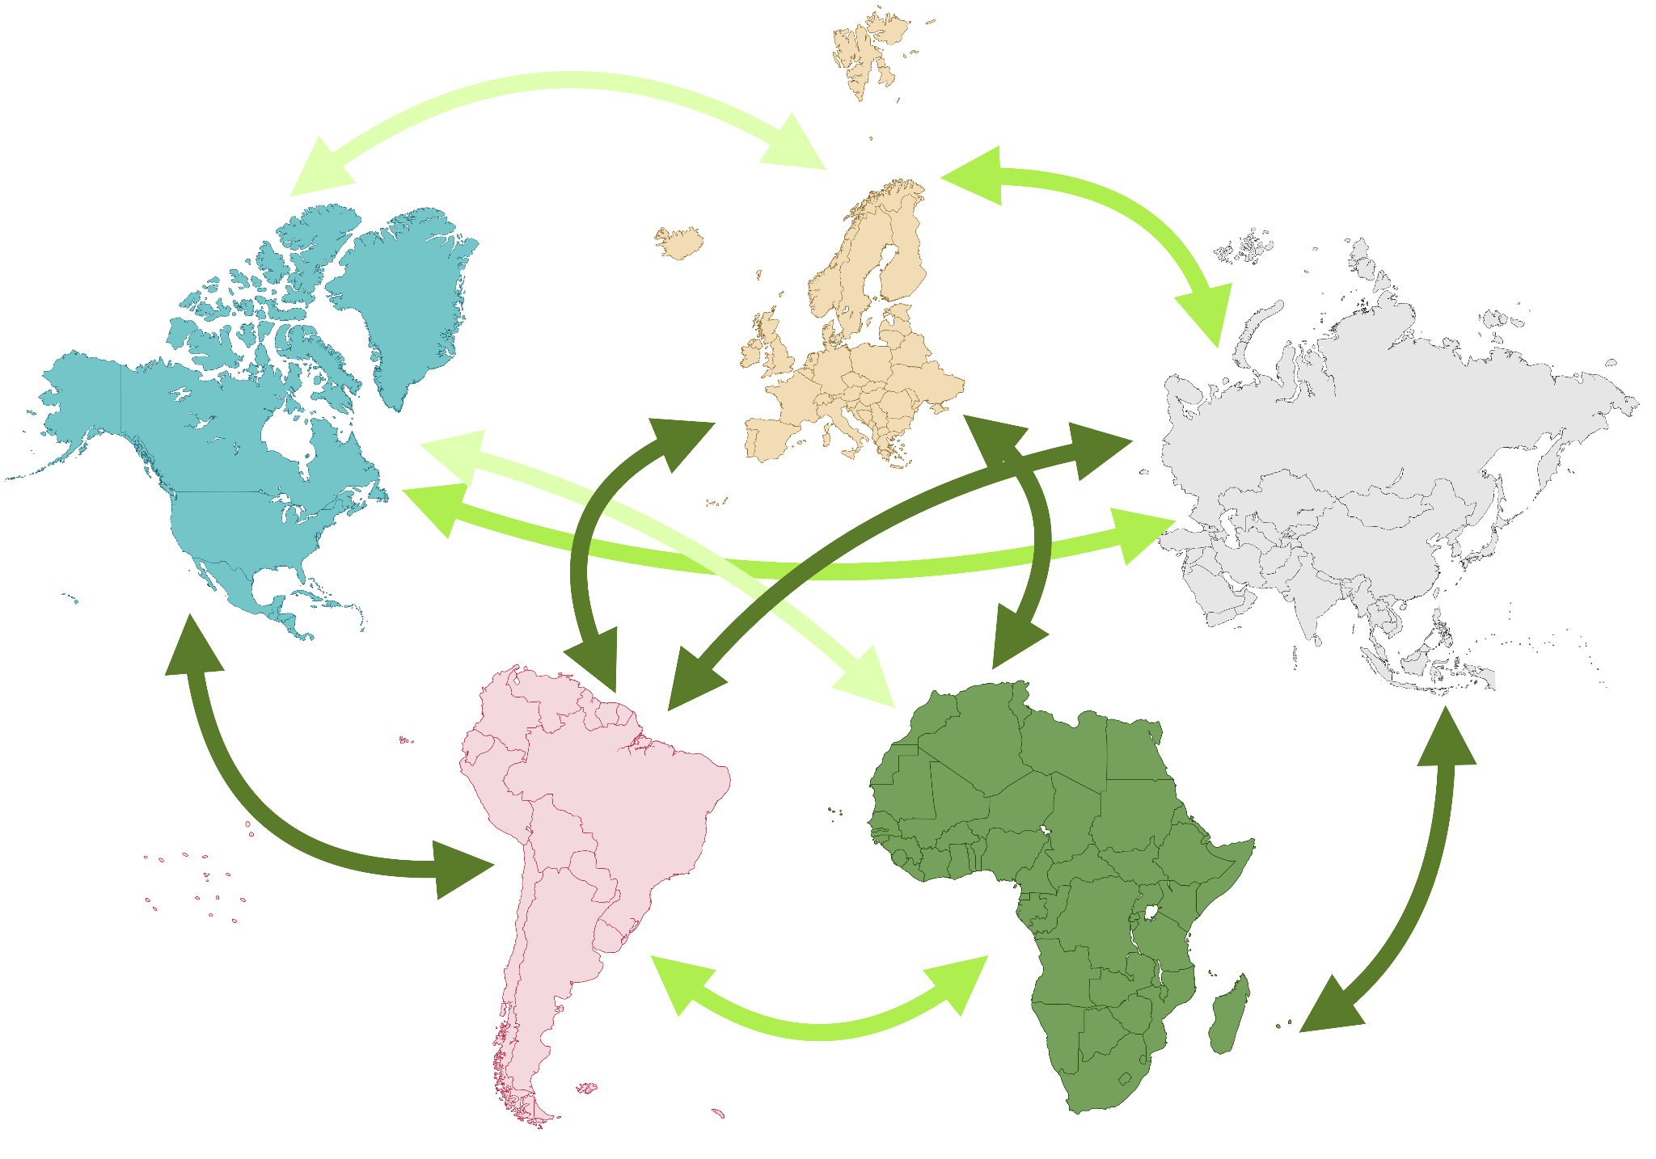
Outbreak Scenario Map: 5 Connected Jurisdictions
All simulated outbreaks originate in Region 1
Pathogen spreads across 5 connected jurisdictions:
  Known cross-jurisdiction transmission rates (low, medium, and high movement corridors)
  Allows us to compare inferred importation rates against the true outbreak history
3
4
1
2
5
Part 3/5: Scenarios

Slide 20
Interpreting Tool Output

Slide 21
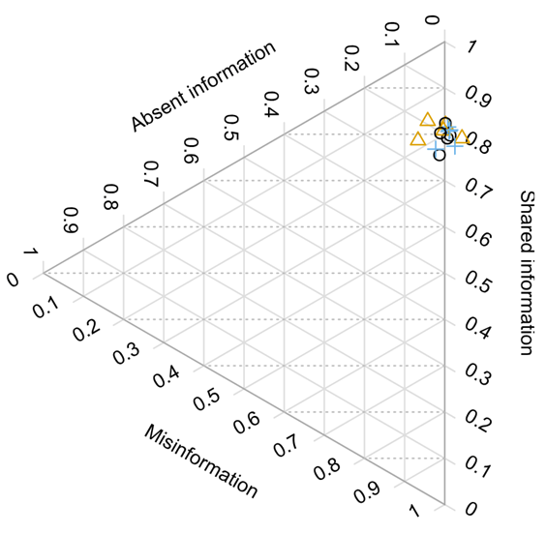
Output Interpretation 1: Tree Shape & Case Grouping
How accurately does the tree group related cases without creating false links?
  Shared information: True transmission groupings accurately recovered in the tree
  Absent information: Branches left unresolved due to limited genetic signal
  Misinformation: False case groupings compared to the true outbreak history
Takeaway: All three subsampling strategies preserve overall tree topology
Part 4/5: Interpretation

Slide 22
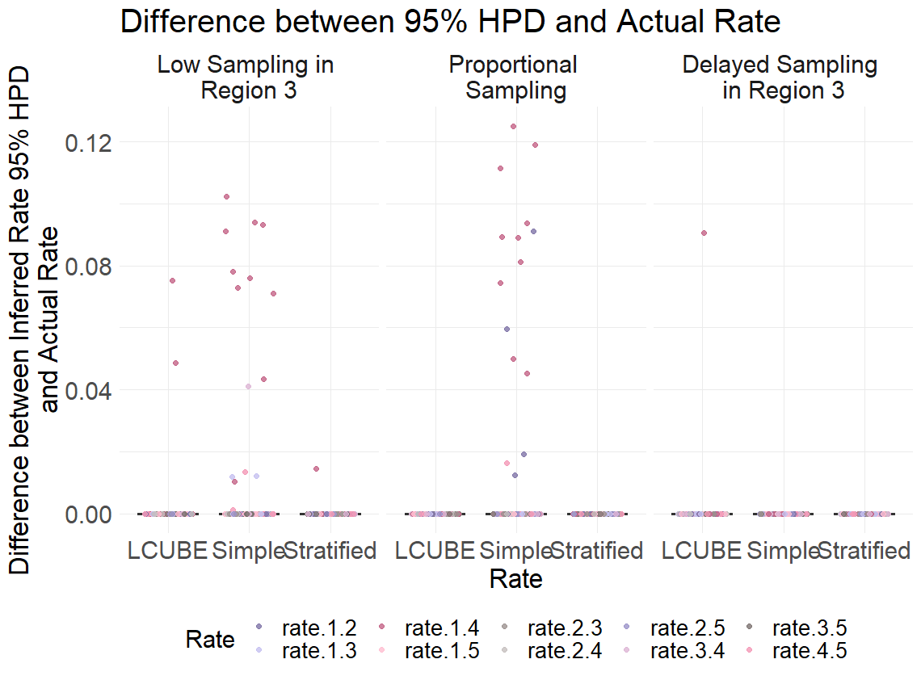
Output Interpretation 2: Cross-Region Rates & Uncertainty
Transition rate: Estimated pathogen movement rate between jurisdictions
95% HPD (Credible Interval): 95% uncertainty range for the true rate
Reading the plot: Points at 0.00 mean the 95% interval captured the true movement rate
LCUBE & Stratified maintain high accuracy; Simple Random misses true rates
3
Part 4/5: Interpretation

Slide 23
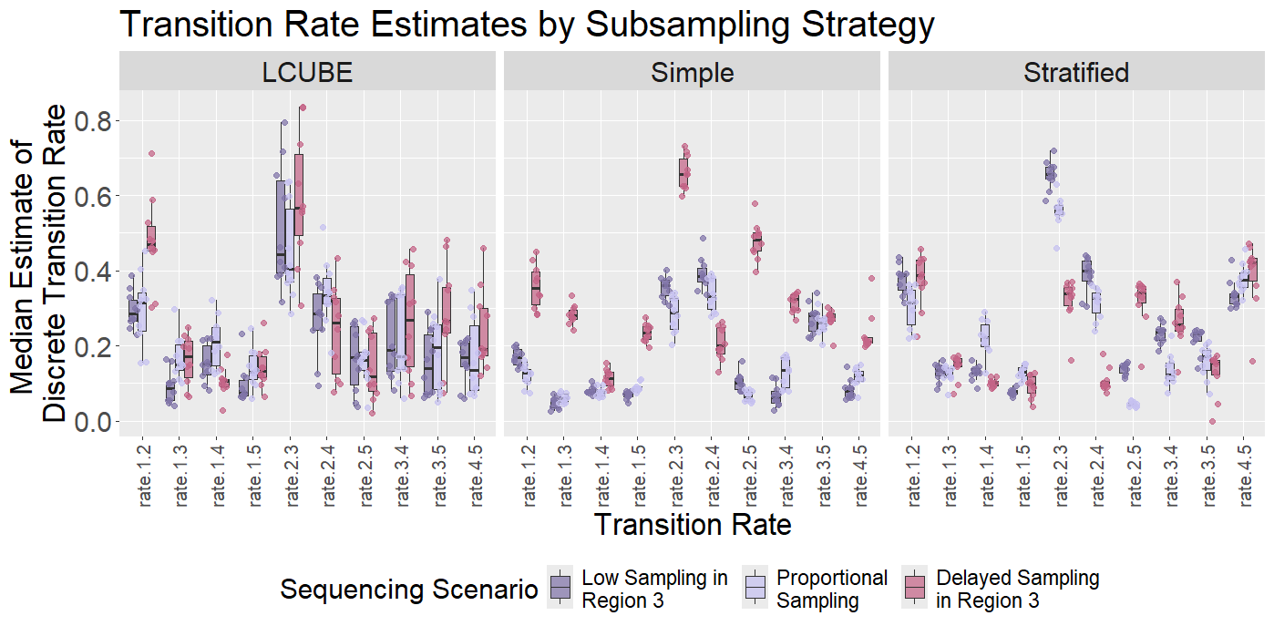
Output Interpretation 3: Spotting Surveillance Bias
Uneven or delayed sequencing shifts point estimates of cross-region importation
Simple & Stratified Random yield narrow, overconfident intervals around biased estimates
PAST (LCUBE) captures wider, realistic uncertainty across resamples
Part 4/5: Interpretation

Slide 24
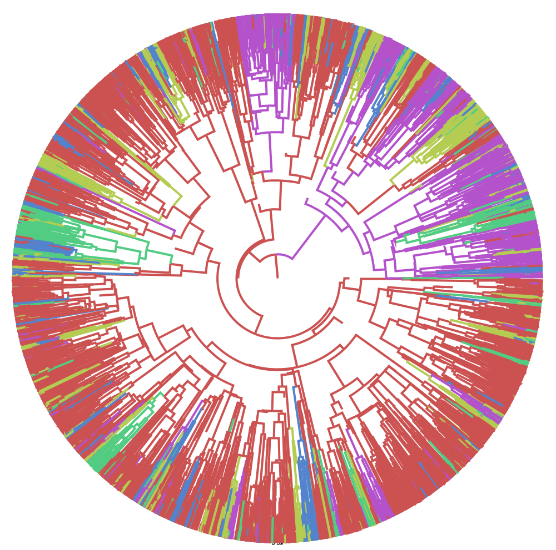
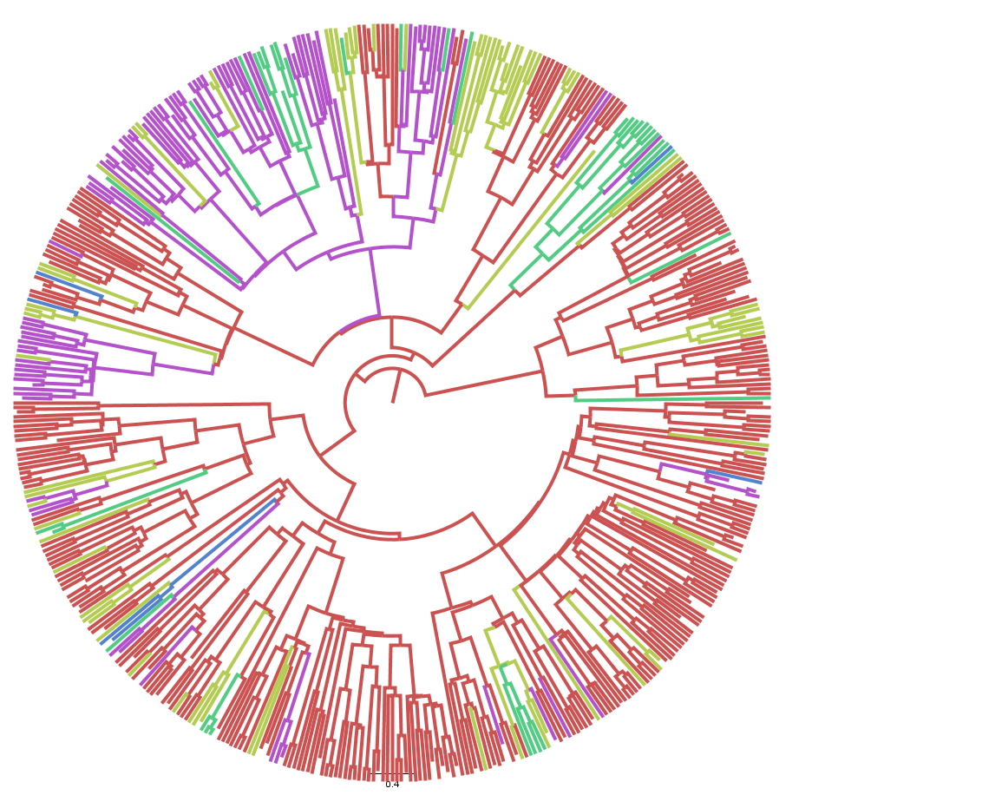
Visualizing the Output Tree: Preserving Key Lineages
Part 4/5: Interpretation

Slide 25
Conclusions, Limitations & Group Exercises

Slide 26
Interpreting PAST Output: Conclusions You Can and Cannot Draw
Conclusions You CAN Draw from Subsampled Phylodynamic Output:
  Identify broad regional source-sink patterns and major cross-jurisdiction introduction corridors
  Evaluate whether importation rate estimates are robust or highly uncertain by inspecting the 95% credible interval (HPD)
  Determine whether conclusions remain stable across Simple Random, Stratified, and LCUBE subsampling
Conclusions You CANNOT Draw:
  Cannot infer direct person-to-person or farm-to-farm transmission pairs ('who infected whom') from regional phylogeography
  Cannot treat point estimates from convenience samples as exact counts of importation events
  Cannot infer absence of transmission in jurisdictions or host species that have zero sequences
Part 5/5: Conclusions

Slide 27
Small-Group Discussion: Interpreting Output (15 Minutes)
Question 1 — High- vs. Low-Resource Jurisdictions
  How does Simple Random sampling change your conclusion about whether Region 1 is the primary source of introductions compared to PAST (LCUBE)?
Question 2 — Delayed Regional Surveillance
  Why do transition rate point estimates shift when one region sequences late? What are some strategies to mitigate this source of bias?
Question 3 — Designing Your Subsampling Strategy:
  If your jurisdiction experiences a high case surge but limited sequencing capacity during peak weeks, which metadata variables would you balance or weight on in PAST?
Part 5/5: Group Exercise

Slide 28
Output Interpretation 1: Tree Shape & Case Grouping
How accurately does the tree group related cases without creating false links?
  Shared information: True transmission groupings accurately recovered in the tree
  Absent information: Branches left unresolved due to limited genetic signal
  Misinformation: False case groupings compared to the true outbreak history
Takeaway: All three subsampling strategies preserve overall tree topology
Part 4/5: Interpretation

Slide 29
Output Interpretation 2: Cross-Region Rates & Uncertainty
Transition rate: Estimated pathogen movement rate between jurisdictions
95% HPD (Credible Interval): 95% uncertainty range for the true rate
Reading the plot: Points at 0.00 mean the 95% interval captured the true movement rate
LCUBE & Stratified maintain high accuracy; Simple Random misses true rates
3
Part 4/5: Interpretation

Slide 30
Output Interpretation 3: Spotting Surveillance Bias
Uneven or delayed sequencing shifts point estimates of cross-region importation
Simple & Stratified Random yield narrow, overconfident intervals around biased estimates
PAST (LCUBE) captures wider, realistic uncertainty across resamples
Part 4/5: Interpretation

Slide 31
Large-Group Debrief: Discussion Key (10 Minutes)
Response 1 — High- vs. Low-Resource Jurisdictions:
  Simple Random under-samples the low-resource jurisdiction, masking bidirectional spread; LCUBE preserves regional representation so low-resource transmission corridors are detected
Response 2 — Delayed Regional Surveillance:
  Missing late sequences underestimates ongoing local spread; reporting LCUBE’s wider 95% credible interval prevents overconfident policy decisions based on a biased point estimate
Response 3 — Designing Your Subsampling Strategy:
  Balance on collection date (temporal spread) and jurisdiction (spatial distance), and weight inclusion by regional case counts so under-sequenced peak weeks are represented
Part 5/5: Group Debrief

Slide 32
Key takeaways
Cross-jurisdiction transmission estimates are highly sensitive to local sequencing capacity and timing
Simple and stratified random subsampling can produce consistent yet biased importation estimates under uneven surveillance
PAST balances across multiple surveillance traits to better capture true outbreak variation and uncertainty
Part 5/5: Conclusions

Slide 33
Limitations of PAST & Phylogenetic Interpretation
Subsampling cannot invent missing surveillance data:
  PAST re-balances existing sequences; it cannot recover transmission dynamics for completely unsampled jurisdictions, hosts, or time periods
Balancing quality depends on metadata completeness:
  Inaccurate collection dates, missing county/state labels, or biased case count weights will limit bias correction
Severe surveillance delays still shift point estimates:
  Under extreme delayed regional sequencing, point estimates still drift—analysts must rely on LCUBE’s wider 95% uncertainty bounds rather than point estimates alone
Part 5/5: Conclusions

Slide 34


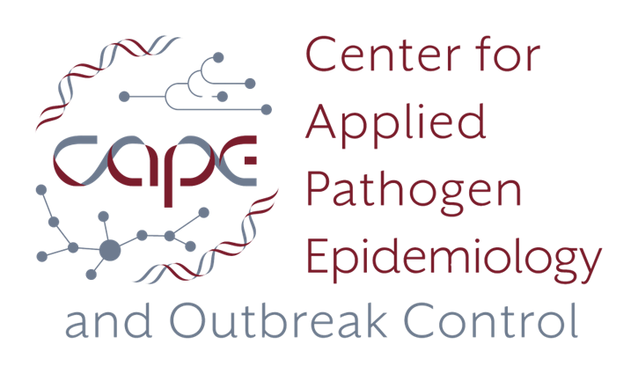
Acknowledgements
Bahl Lab (Applied Molecular Epidemiology Research Group)
  Leke Lyu
  Gabriella Veytsel
  Cody Dailey
  Justin Bahl
  Stephani Mock
PIPP Phase I Research Group
  Barbara Han
  Hailey Robertson
  Ellie Graeden
  John Drake
Institute of Bioinformatics Staff
  April King Mosley
  Sandra Getz
  Jara Usherwood
My dissertation committee
  Amy Winter
  Mandev Gill
  Liang Liu

Slide 35
Summary
Genomic surveillance helps track pathogen spread, but convenience datasets require careful subsampling before phylodynamic analysis
Cross-jurisdiction transmission estimates are strongly affected by low-resource and delayed sequencing scenarios
Simple and stratified random sampling can yield overconfident, biased importation estimates
PAST (LCUBE) balances across time, geography, and host metadata to preserve realistic uncertainty
Always report 95% credible intervals and account for unsampled jurisdictions when briefing public health leadership
Part 5/5: Conclusions
guppy.stott@uga.edu (Guppy Stott, they/them)

Slide 36
Appendix

Slide 37
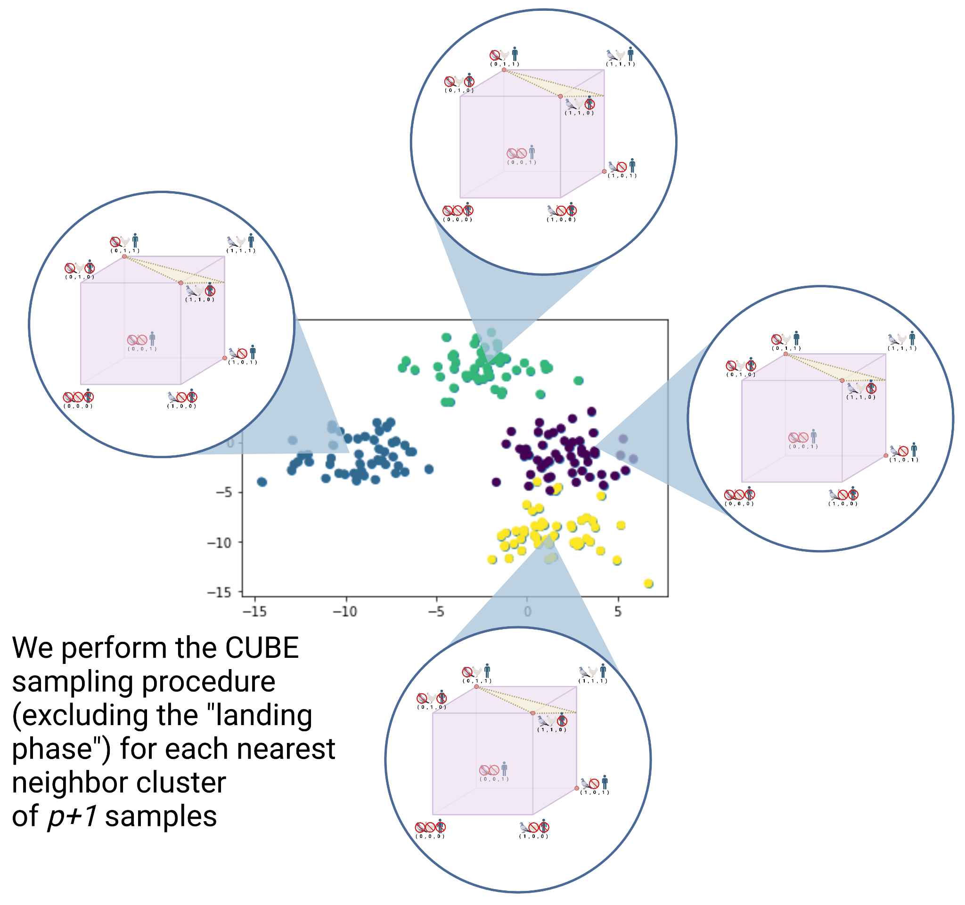
Phase 1: Clustering
Start by creating clusters of p+1 samples
  Where p is the number of balancing variables
For each cluster, we will perform a CUBE subsampling step
Part 2/5: LCUBE

Slide 38
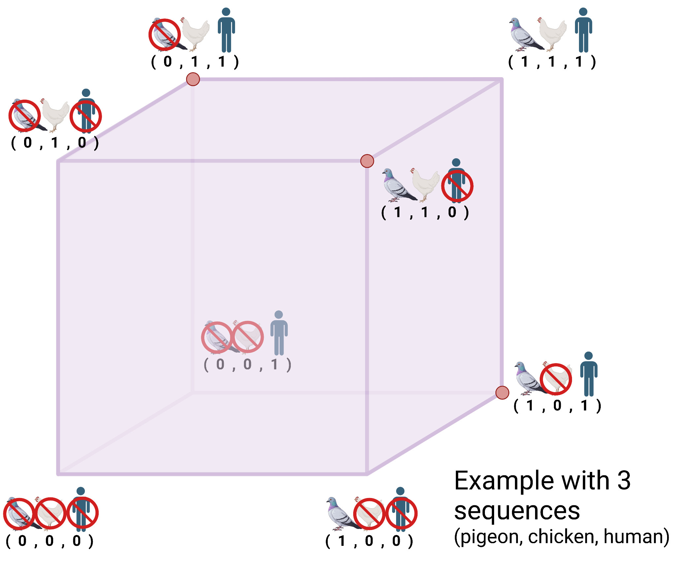
For each cluster, we use cube sampling
Samples in a population can be represented geometrically by an n-dimensional space where n is the total size of the population
In this example, we have a population size of 3 with different hosts: pigeon, chicken, and human.
If we want a sample of size 2, there are 3 valid points (red)
Part 2/5: LCUBE

Slide 39
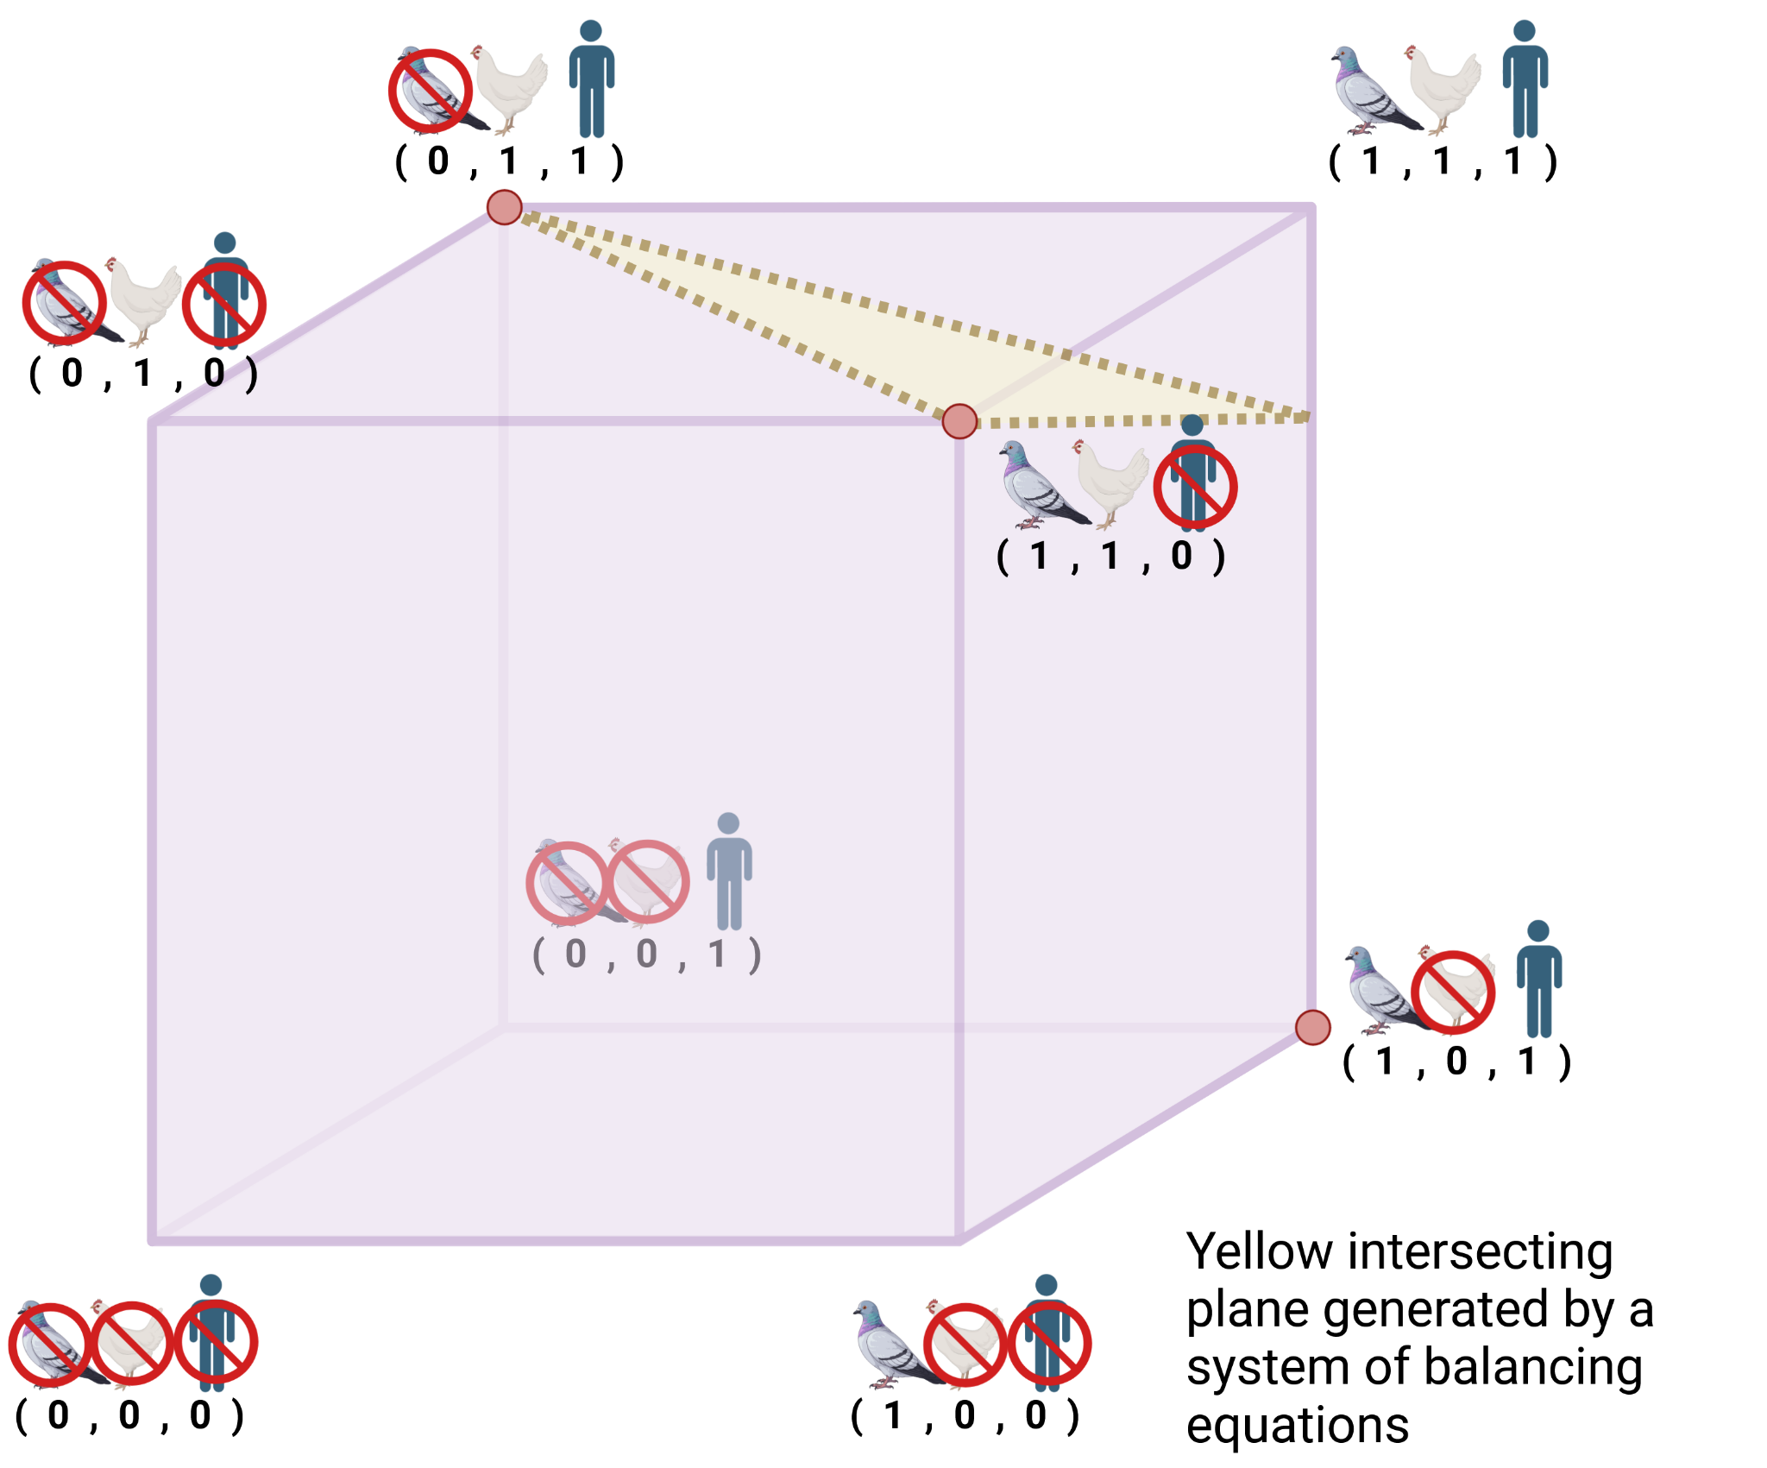
Balancing equations constrain the space
We leverage a system of balancing equations to generate an intersecting plane (yellow)
This plane may intersect a valid sample (e.g. 2 of the red dots) or not
Part 2/5: LCUBE

Slide 40
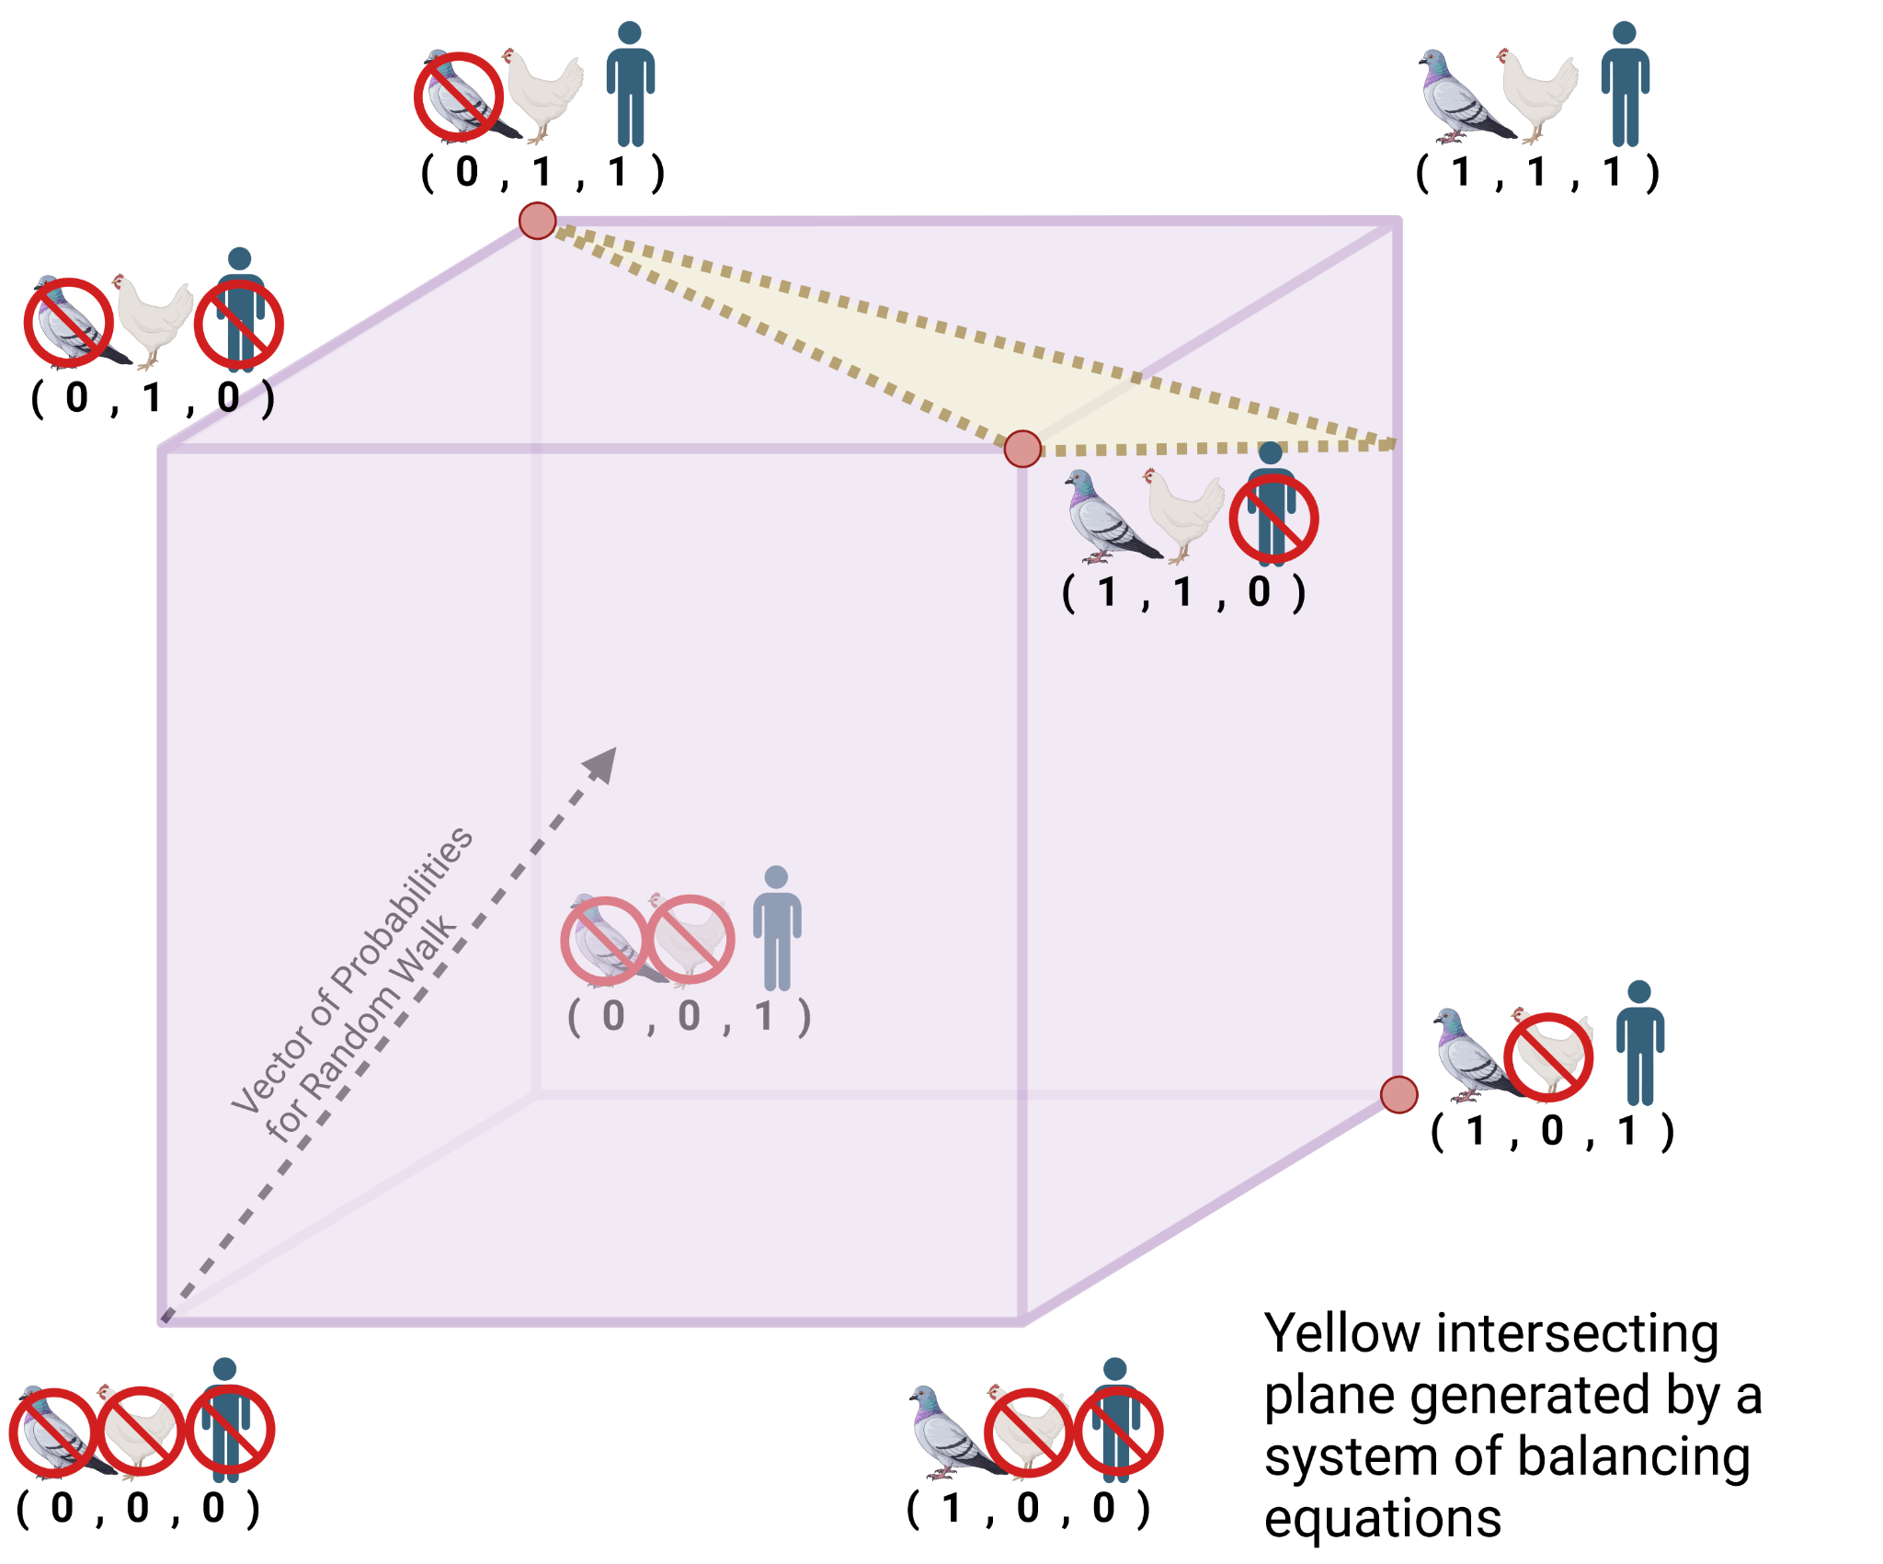
A random walk maintains “randomness”
We then use a probability vector directed towards the surface of balancing equations to begin a random walk
We wander until we reach an edge
At least one individual will be added to our sample at the end of the random walk
Part 2/5: LCUBE

Slide 41
Then, we repeat for the remaining data points
Create clusters of p+1 samples
  Where p is the number of balancing variables
Perform a CUBE subsampling step
  If there are less than p+1 samples left, perform the “landing phase”
Landing phase “rounds up” according to a linear program that optimizes cost of a sample
  Or relaxes the constraint space for large p
Part 2/5: LCUBE

Slide 42
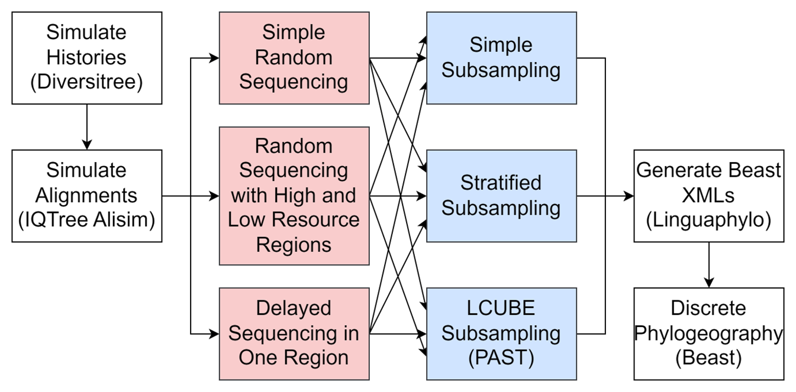
Our Nextflow workflow diagram
Part 3/5: Methodology

Slide 43
Next Steps
Use GeoSSE model to simulate continuous phylogeography
Investigate proportion of tree which accurately infers location
Integrate features like predicted antigenic distance and host distance
Use additional data like outbreak size to weight sample inclusion
Build a user-friendly interface for subsampling to improve adoption
Part 5/5: Conclusions

Slide 44
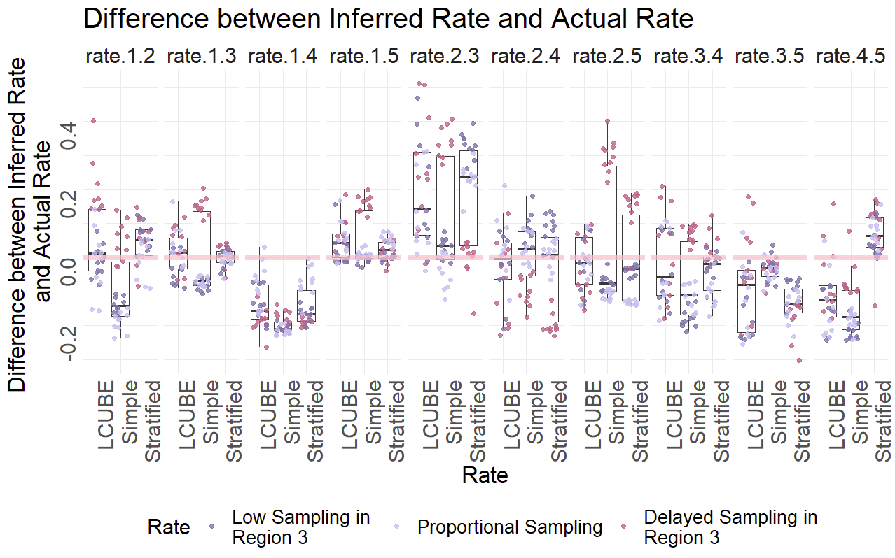

Slide 45
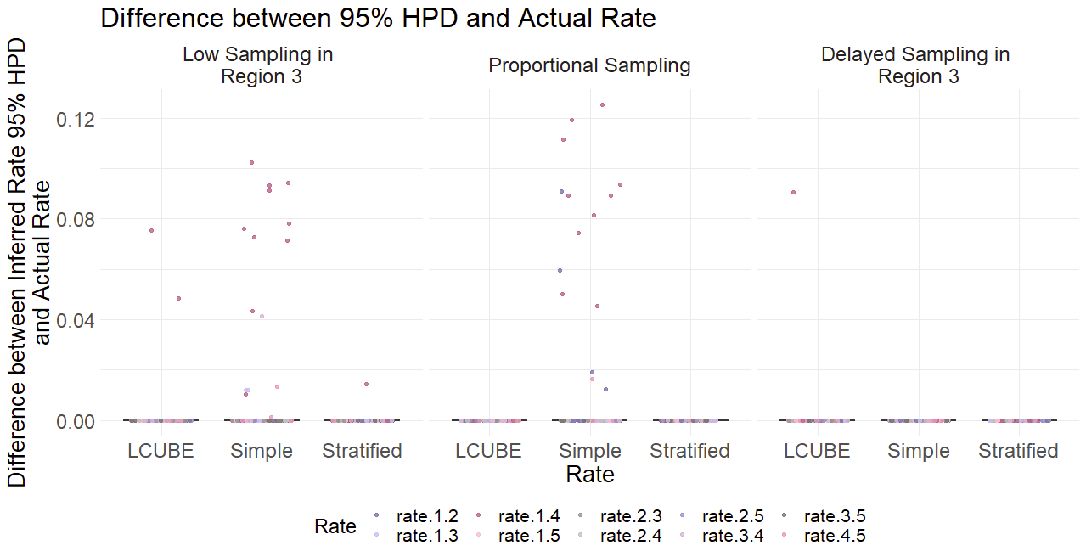

Slide 46
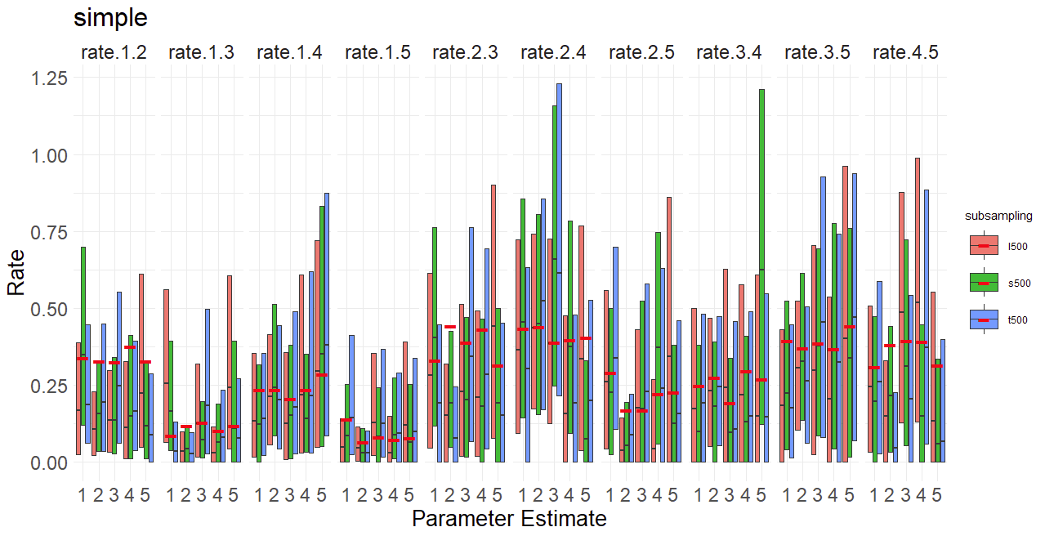

Slide 47
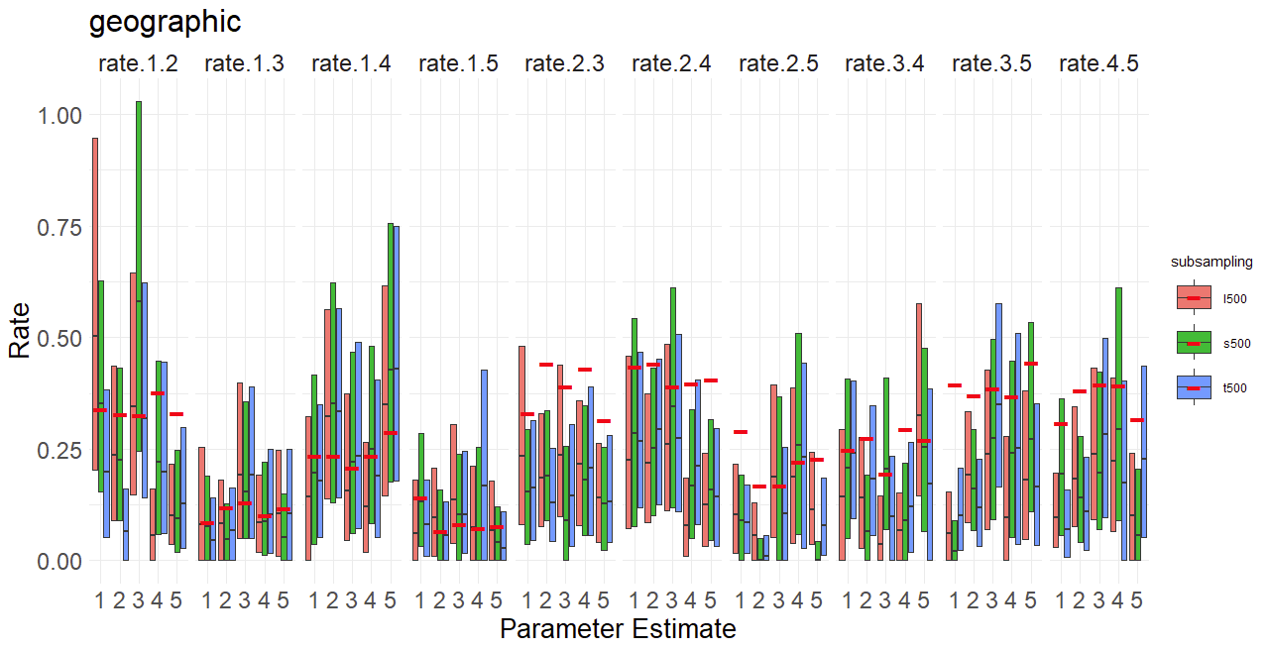

Slide 48
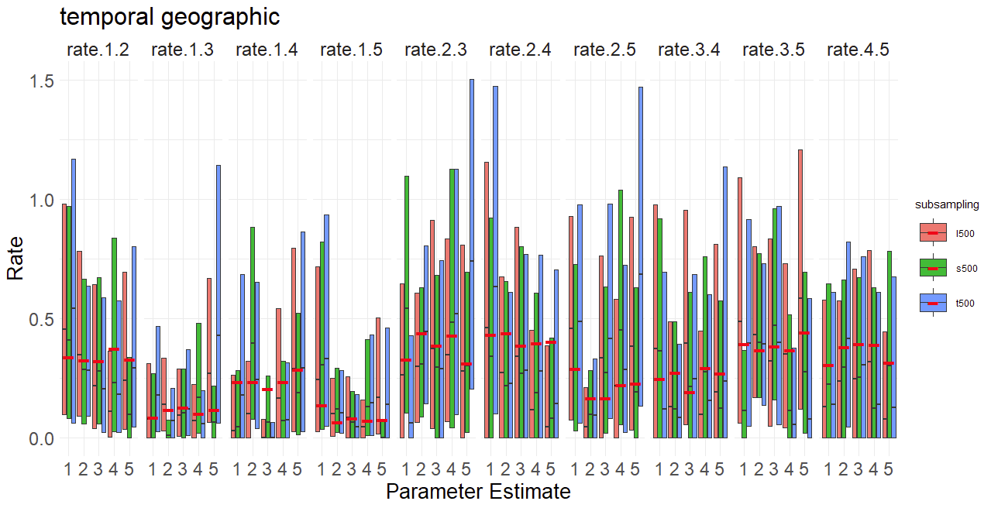

Slide 49
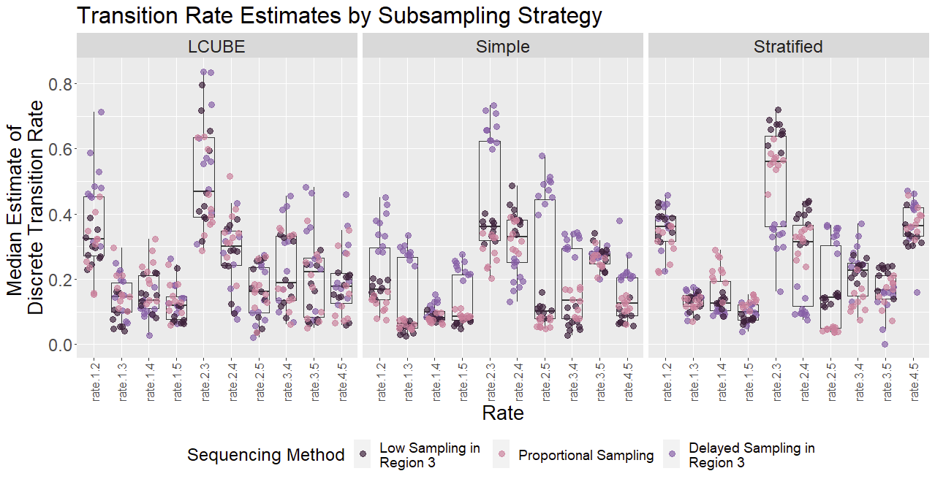
Results Update

Slide 50
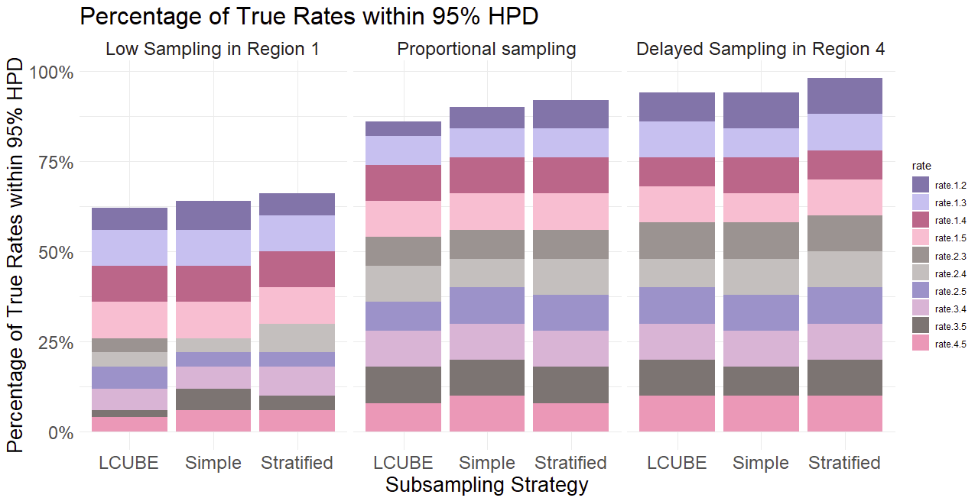
Results update

Slide 51
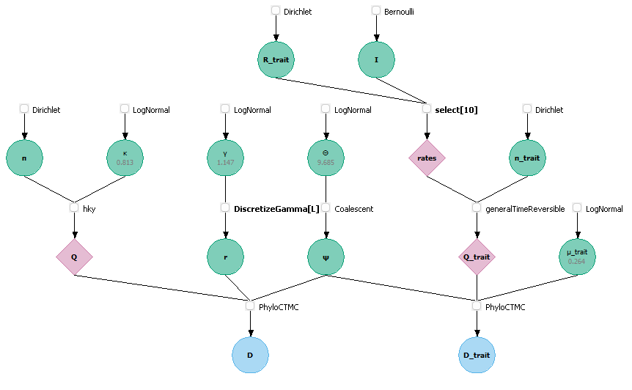
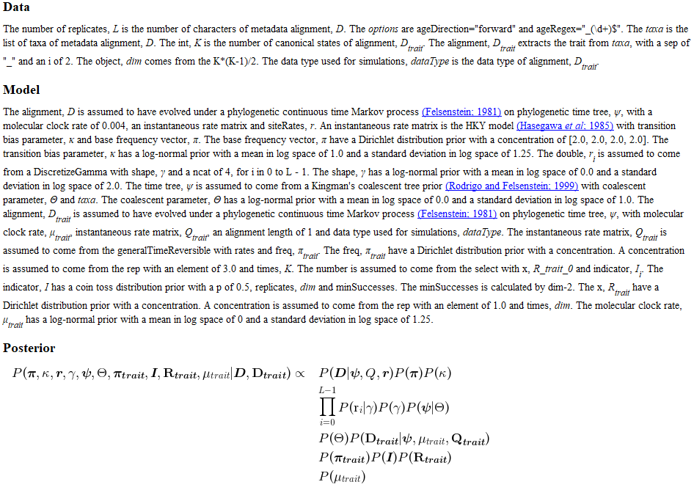
DAG and Model Description

Slide 52
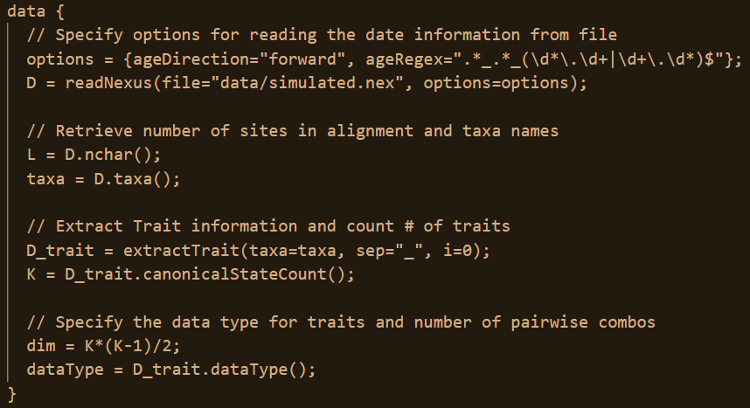
Data Block

Slide 53
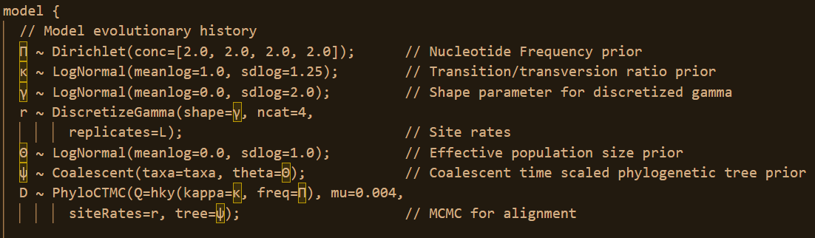
Model Block (Sequence Evolution)

Slide 54
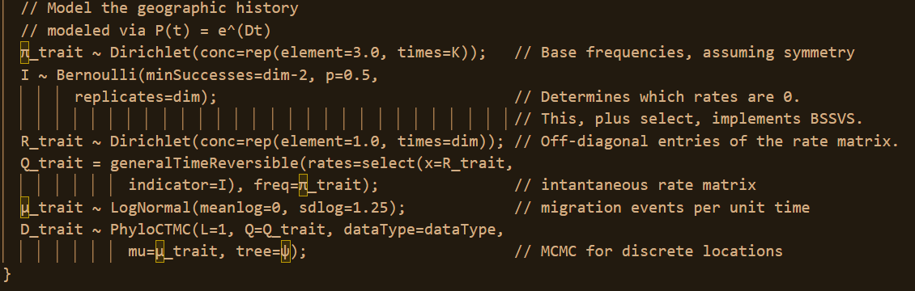
Model Block (Discrete Geography)

